Slide 1
Oracle Retail Analytics
Retail, 20130327

Slide 2


Retail Analytics Story
A Story But Not Fairy Tale
——左拉 RA Adventure
?
BUT
NOT
Notes:
ETL Processing: Overview
The main point to note here is that ETL is a parallel process。Graphic and callouts define the ETL process.

Slide 3

Retail Analytics Story——Question——Scenario 1
Scen 1：
Notes:
ETL Processing: Overview
The main point to note here is that ETL is a parallel process。Graphic and callouts define the ETL process.

Slide 4

Retail Analytics Story——Question
分析视角(维度)：
时间：近三年
组织：各区域
商品：各分部
指标(KPI)：
销售业绩
Notes:
ETL Processing: Overview
The main point to note here is that ETL is a parallel process。Graphic and callouts define the ETL process.

Slide 5

Retail Analytics Story——Answer——Login
http://raap1.bbg.com.cn:9705/analytics/
RA_TEST / RA_TEST123
Notes:
ETL Processing: Overview
The main point to note here is that ETL is a parallel process。Graphic and callouts define the ETL process.

Slide 6


Retail Analytics Story——Answer——Subject Area
Notes:
ETL Processing: Overview
The main point to note here is that ETL is a parallel process。Graphic and callouts define the ETL process.

Slide 7
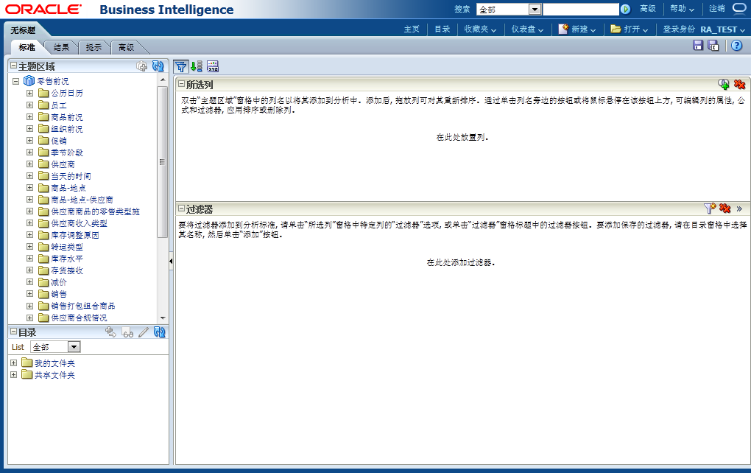
Retail Analytics Story——Answer——Column
维
度
和
指
标
Notes:
ETL Processing: Overview
The main point to note here is that ETL is a parallel process。Graphic and callouts define the ETL process.

Slide 8
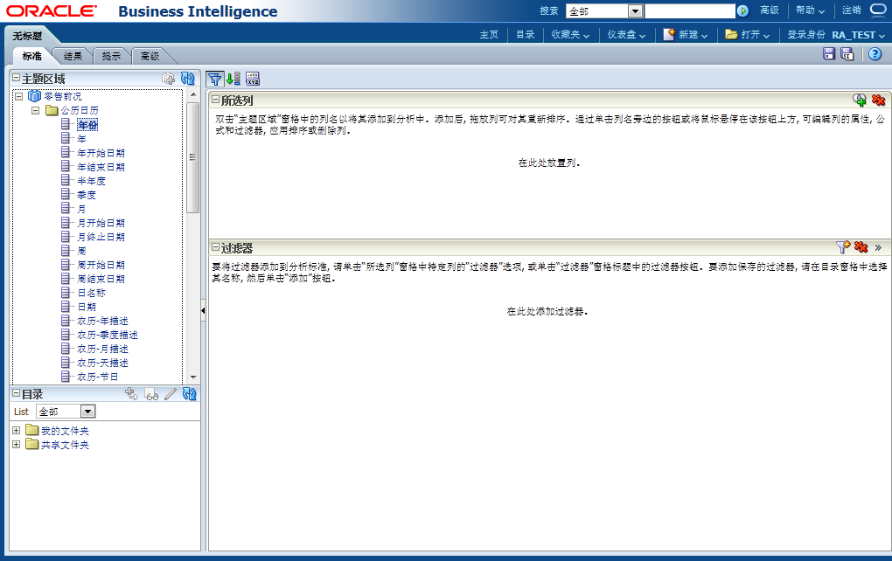

Retail Analytics Story——Answer————Column
Notes:
ETL Processing: Overview
The main point to note here is that ETL is a parallel process。Graphic and callouts define the ETL process.

Slide 9

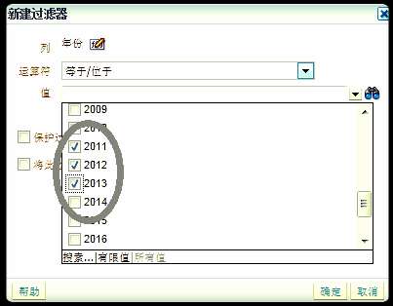
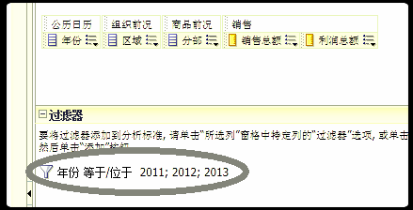
Retail Analytics Story——Answer——Filter
Notes:
ETL Processing: Overview
The main point to note here is that ETL is a parallel process。Graphic and callouts define the ETL process.

Slide 10
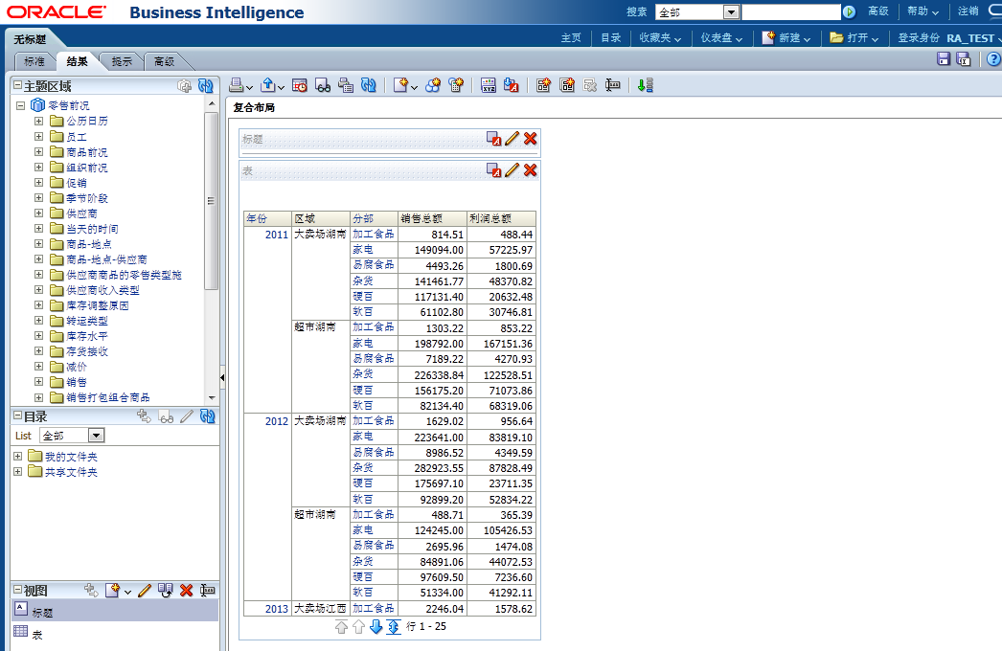
Retail Analytics Story——Answer——复合布局
Notes:
ETL Processing: Overview
The main point to note here is that ETL is a parallel process。Graphic and callouts define the ETL process.

Slide 11
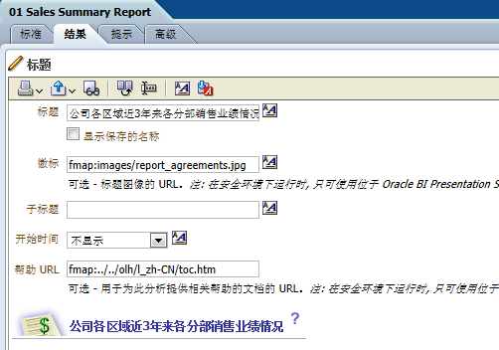
Retail Analytics Story——Answer——标题视图
Notes:
ETL Processing: Overview
The main point to note here is that ETL is a parallel process。Graphic and callouts define the ETL process.

Slide 12

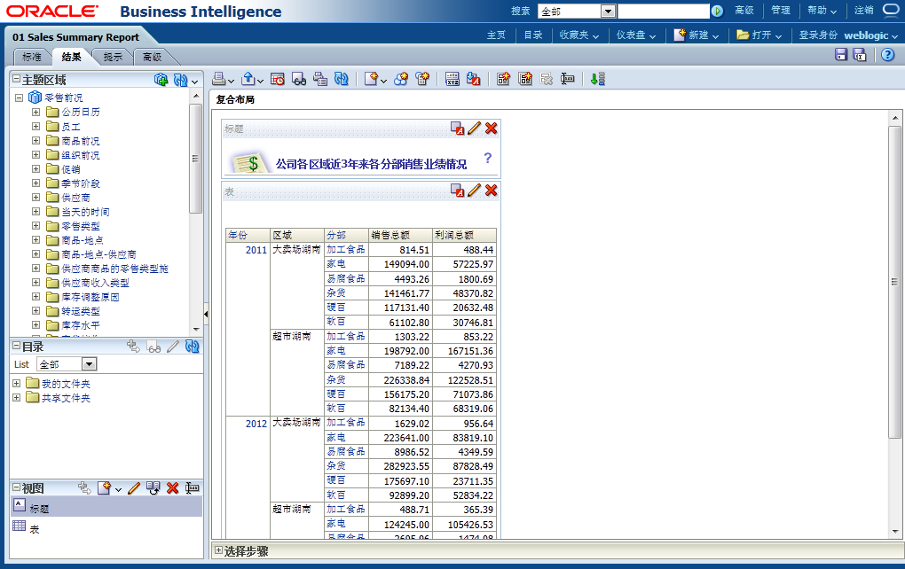
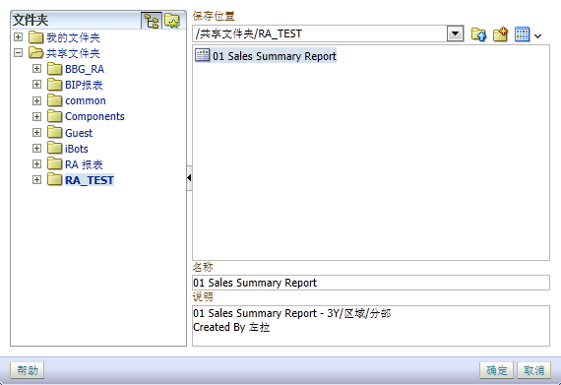
Retail Analytics Story——Answer——保存
Notes:
ETL Processing: Overview
The main point to note here is that ETL is a parallel process。Graphic and callouts define the ETL process.

Slide 13
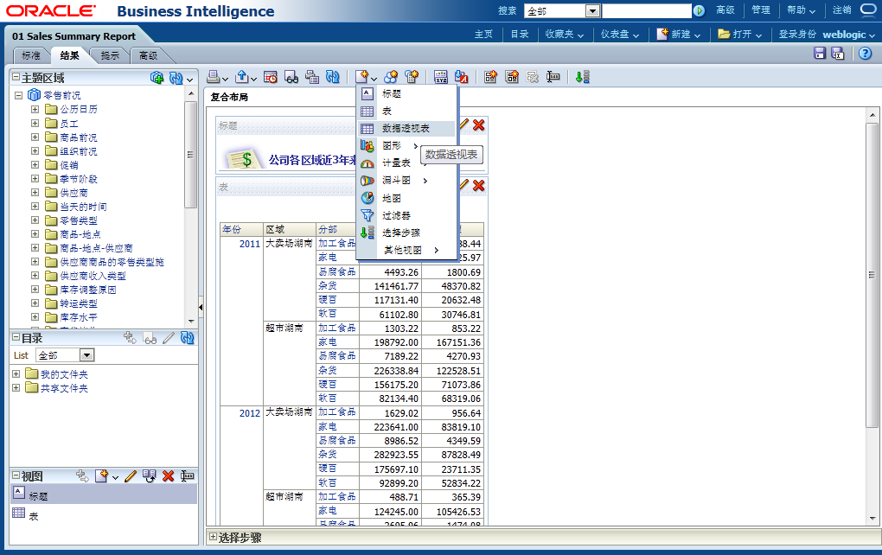

Retail Analytics Story——Answer——数据透视表视图
Notes:
ETL Processing: Overview
The main point to note here is that ETL is a parallel process。Graphic and callouts define the ETL process.

Slide 14
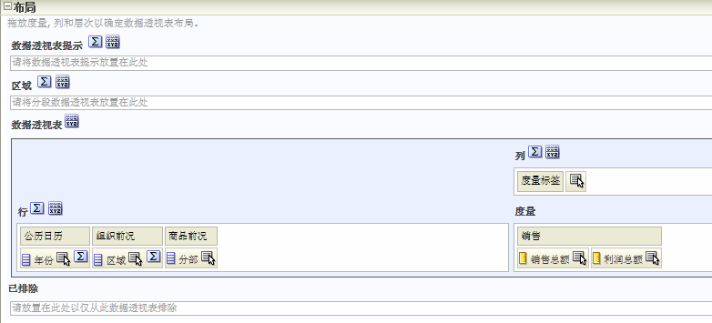
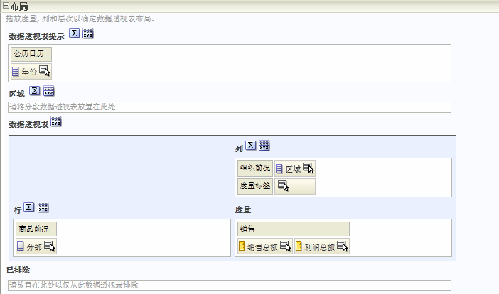
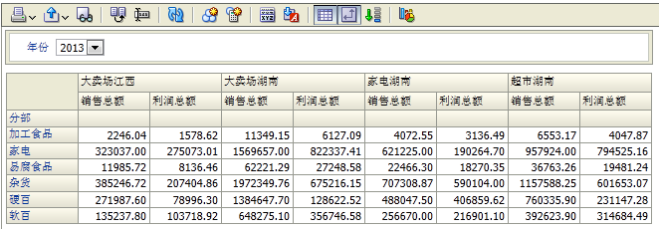
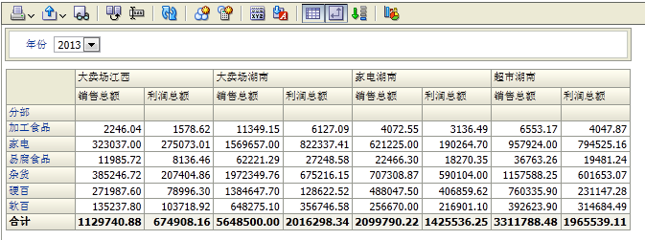
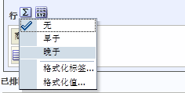
Retail Analytics Story——Answer——View
Notes:
ETL Processing: Overview
The main point to note here is that ETL is a parallel process。Graphic and callouts define the ETL process.

Slide 15
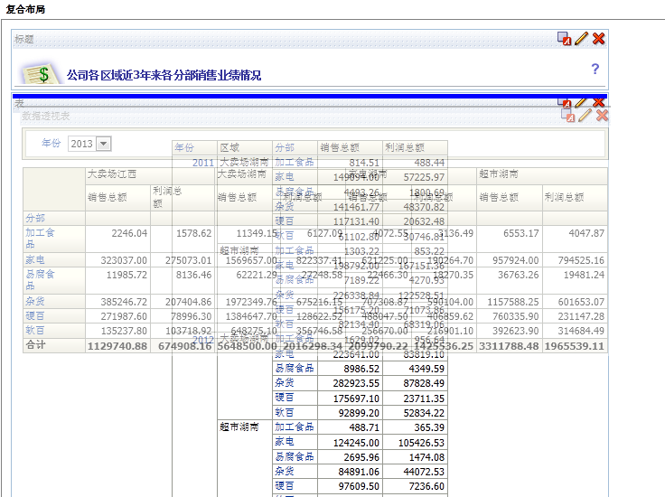
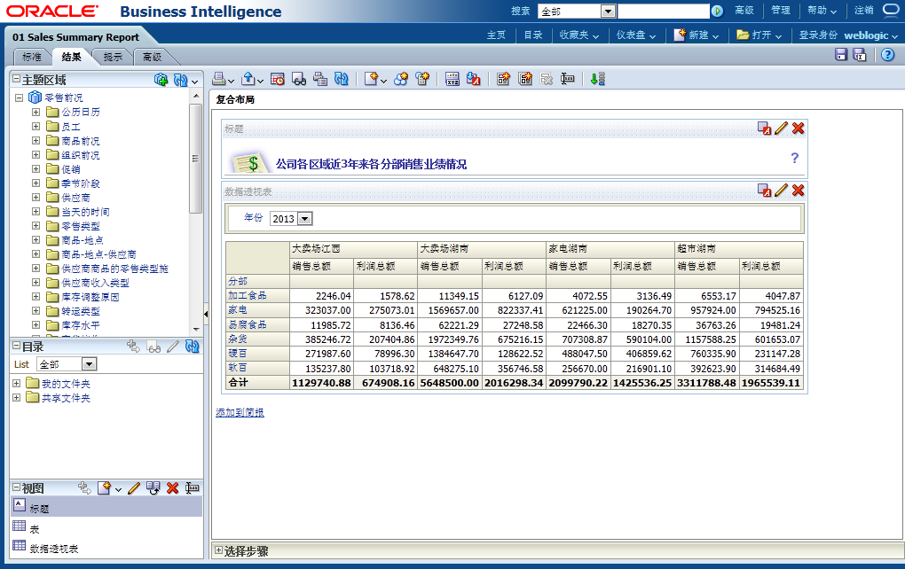
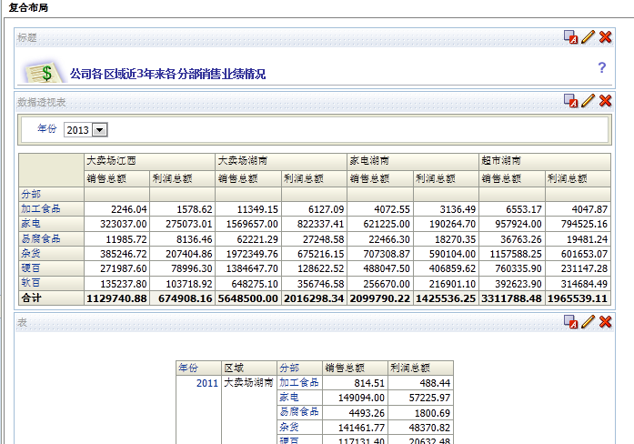
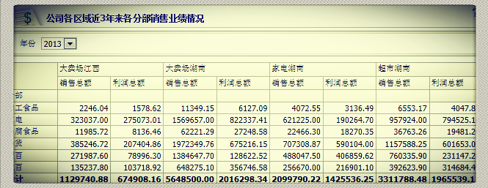
Retail Analytics Story——Answer——数据透视表视图
Notes:
ETL Processing: Overview
The main point to note here is that ETL is a parallel process。Graphic and callouts define the ETL process.

Slide 16
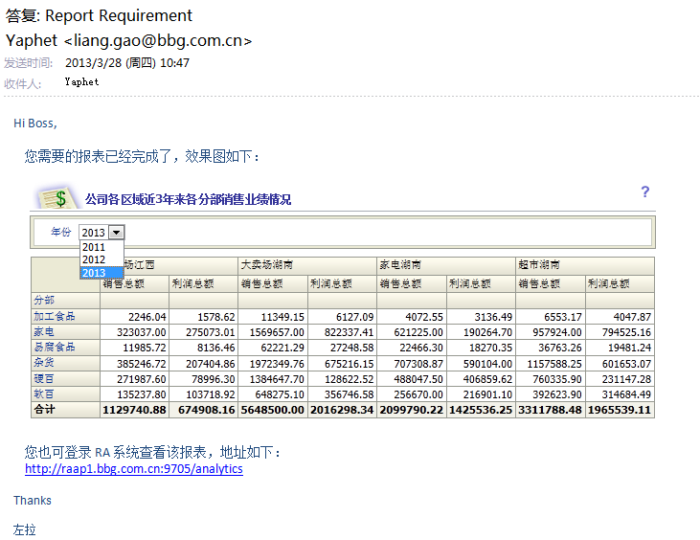
Retail Analytics Story——Question——Scenario 2
Scen 2：
Notes:
ETL Processing: Overview
The main point to note here is that ETL is a parallel process。Graphic and callouts define the ETL process.

Slide 17
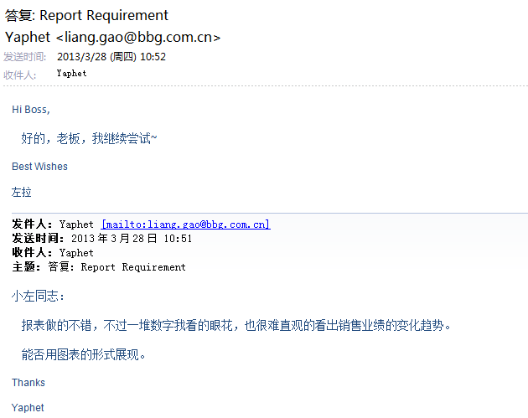
Retail Analytics Story——Question——Scenario 2
Scen 2：
Notes:
ETL Processing: Overview
The main point to note here is that ETL is a parallel process。Graphic and callouts define the ETL process.

Slide 18
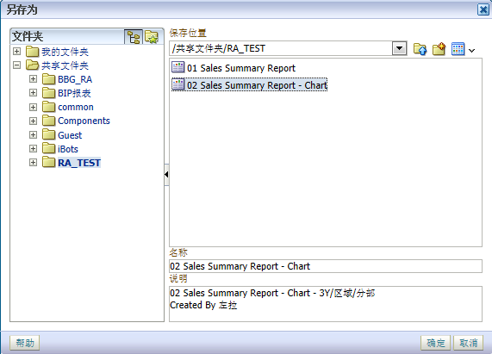
Retail Analytics Story——Answer——另存为
Notes:
ETL Processing: Overview
The main point to note here is that ETL is a parallel process。Graphic and callouts define the ETL process.

Slide 19
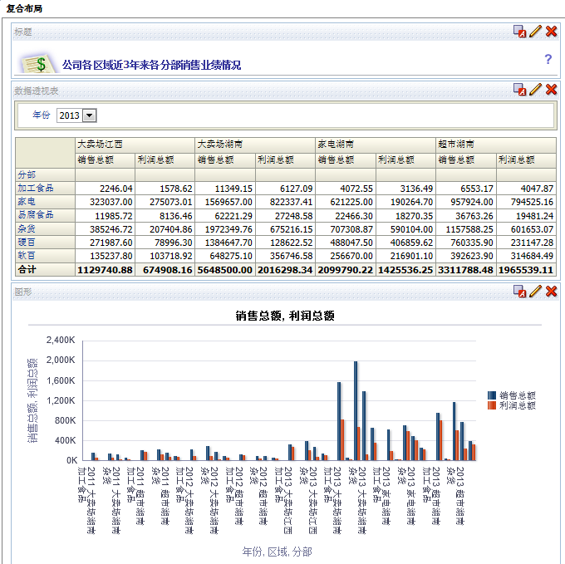
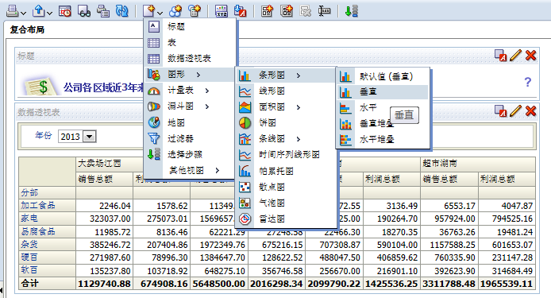
Retail Analytics Story——Answer——图表视图
Notes:
ETL Processing: Overview
The main point to note here is that ETL is a parallel process。Graphic and callouts define the ETL process.

Slide 20
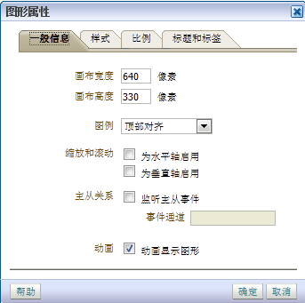

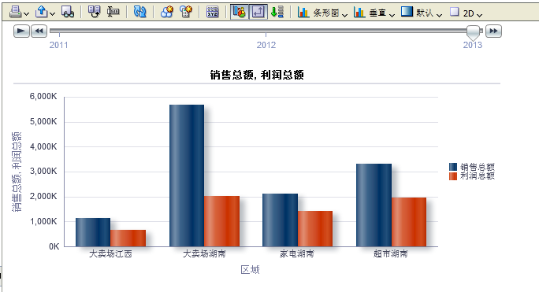
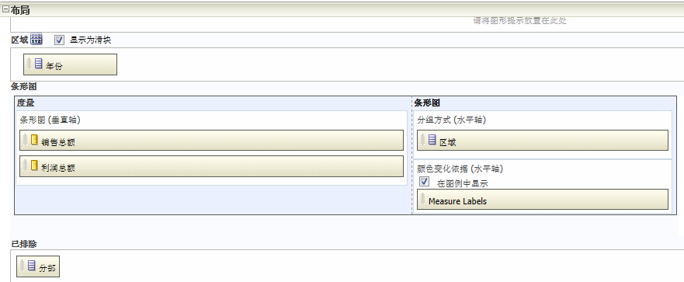
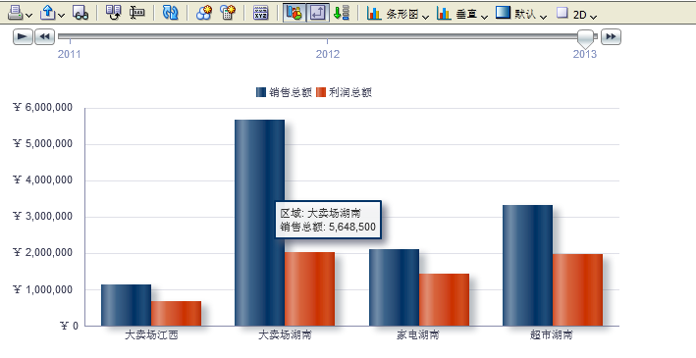
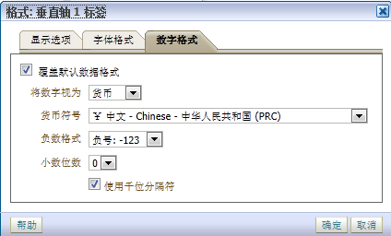
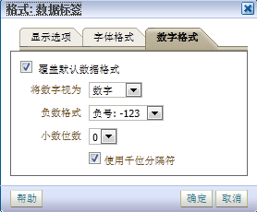
Retail Analytics Story——Answer——条形图视图
Notes:
ETL Processing: Overview
The main point to note here is that ETL is a parallel process。Graphic and callouts define the ETL process.

Slide 21

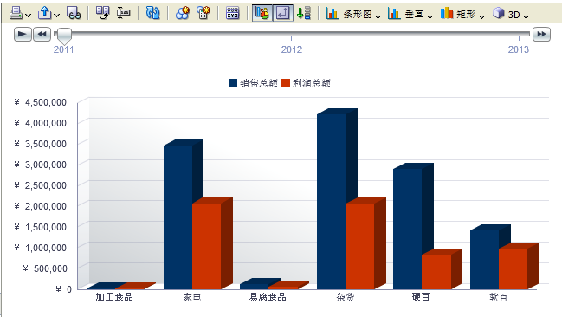
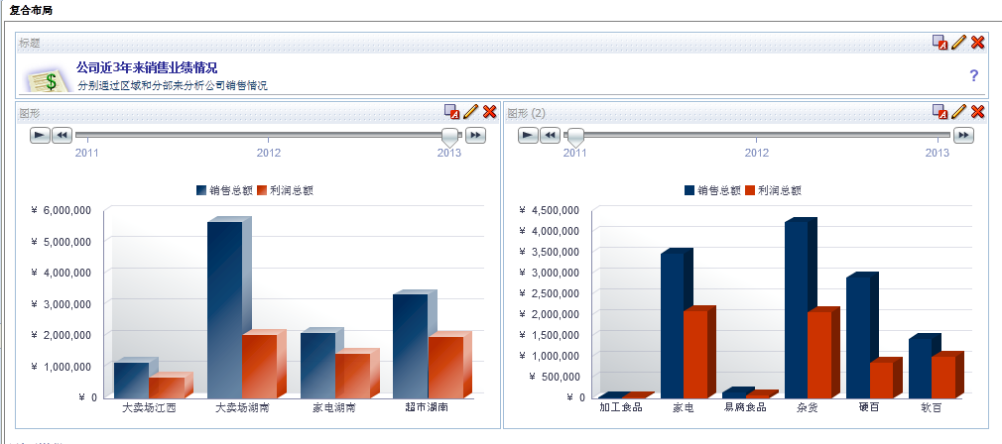
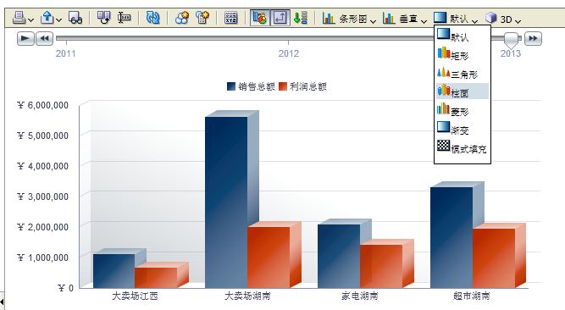
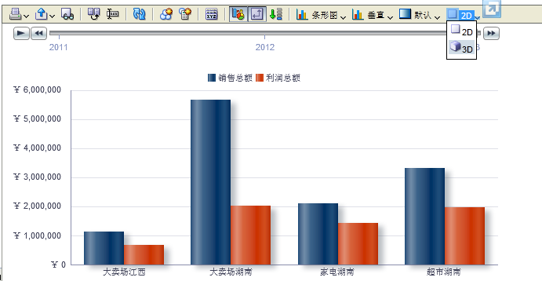
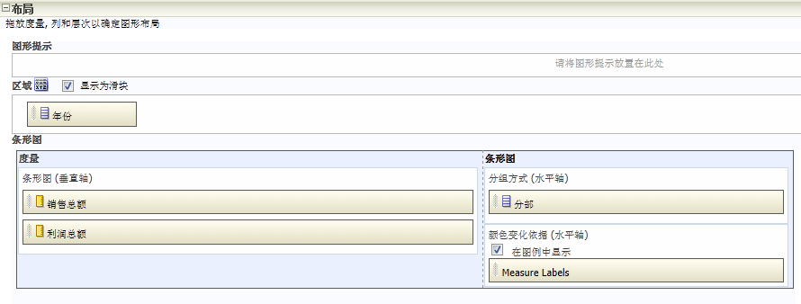
Retail Analytics Story——Answer——条形图视图
Notes:
ETL Processing: Overview
The main point to note here is that ETL is a parallel process。Graphic and callouts define the ETL process.

Slide 22

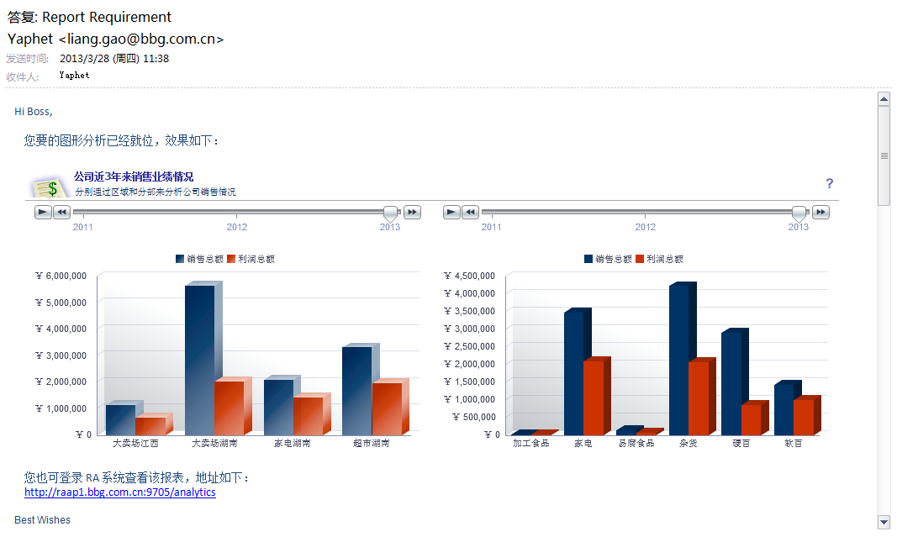
Retail Analytics Story——Question——Scenario 3
Scen 3：
Notes:
ETL Processing: Overview
The main point to note here is that ETL is a parallel process。Graphic and callouts define the ETL process.

Slide 23
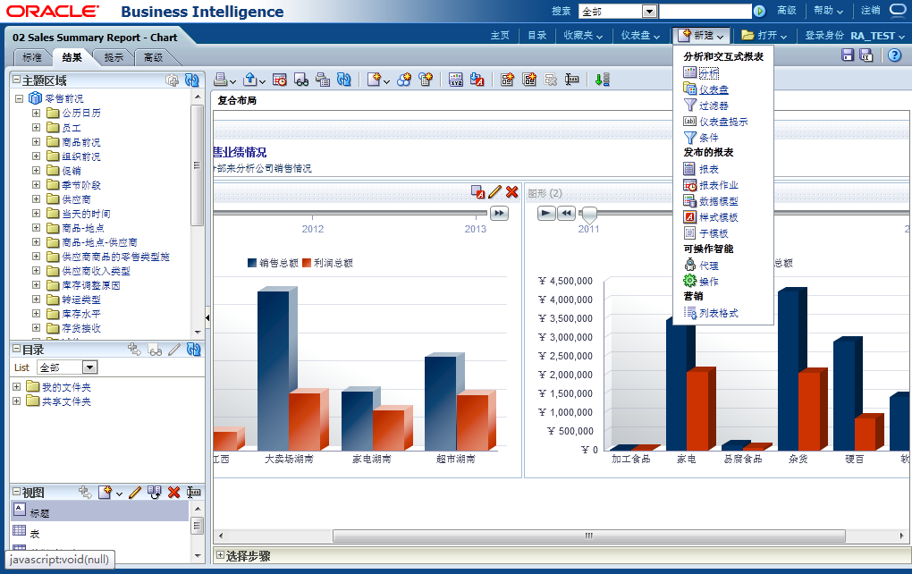
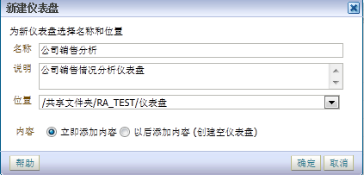
Retail Analytics Story——Dashboard——新建
Notes:
ETL Processing: Overview
The main point to note here is that ETL is a parallel process。Graphic and callouts define the ETL process.

Slide 24
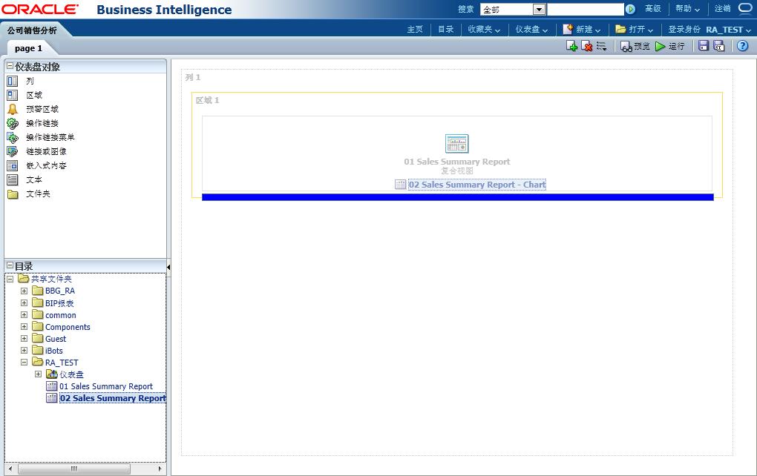
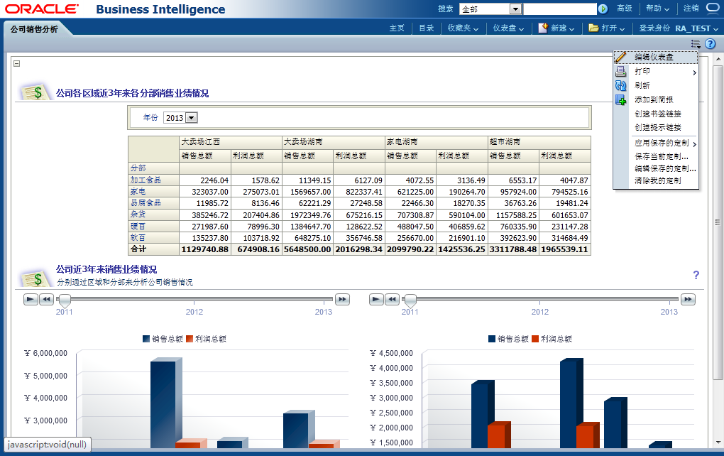
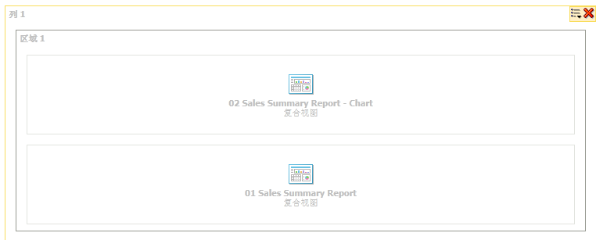
Retail Analytics Story——Dashboard——布局
Notes:
ETL Processing: Overview
The main point to note here is that ETL is a parallel process。Graphic and callouts define the ETL process.

Slide 25
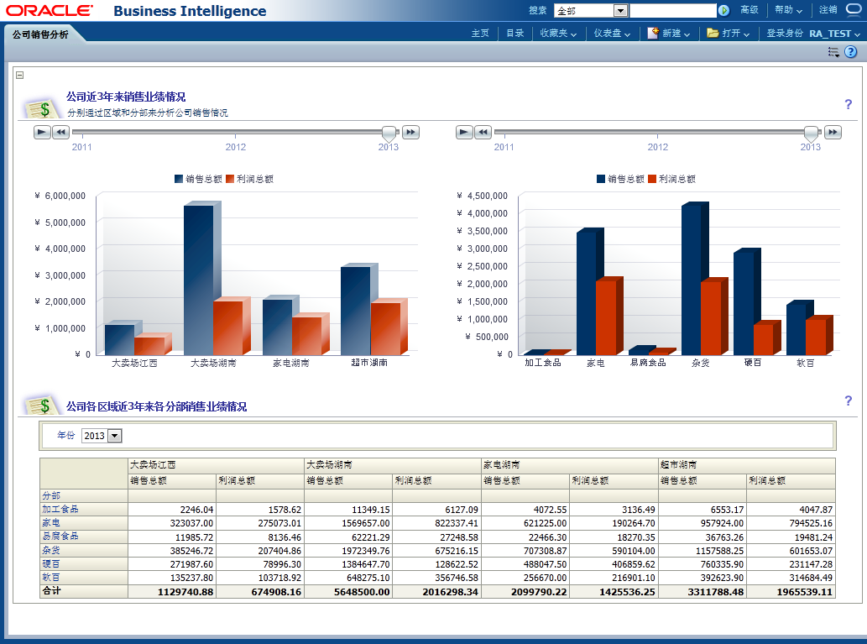
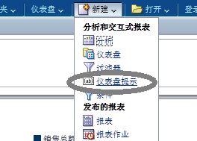
Retail Analytics Story——Dashboard——仪表盘提示
Notes:
ETL Processing: Overview
The main point to note here is that ETL is a parallel process。Graphic and callouts define the ETL process.

Slide 26
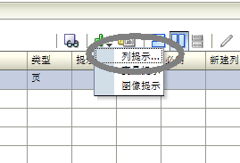
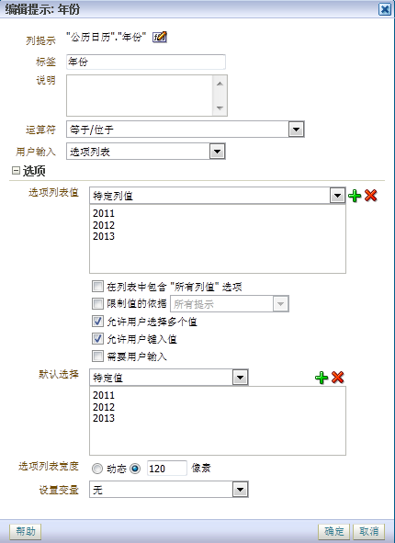
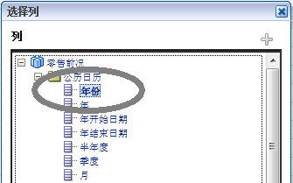
Retail Analytics Story——Dashboard——仪表盘提示
Notes:
ETL Processing: Overview
The main point to note here is that ETL is a parallel process。Graphic and callouts define the ETL process.

Slide 27
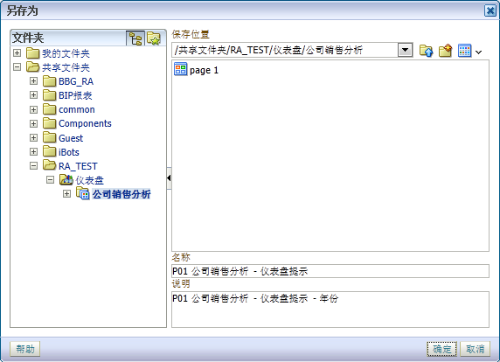

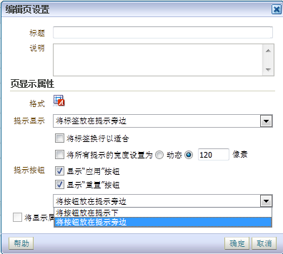
Retail Analytics Story——Dashboard——仪表盘提示
Notes:
ETL Processing: Overview
The main point to note here is that ETL is a parallel process。Graphic and callouts define the ETL process.

Slide 28
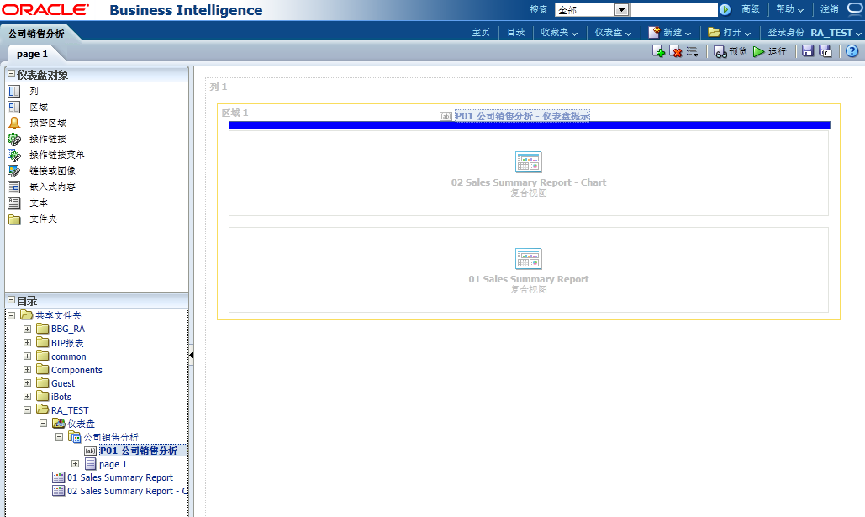
Retail Analytics Story——Dashboard——布局
Notes:
ETL Processing: Overview
The main point to note here is that ETL is a parallel process。Graphic and callouts define the ETL process.

Slide 29
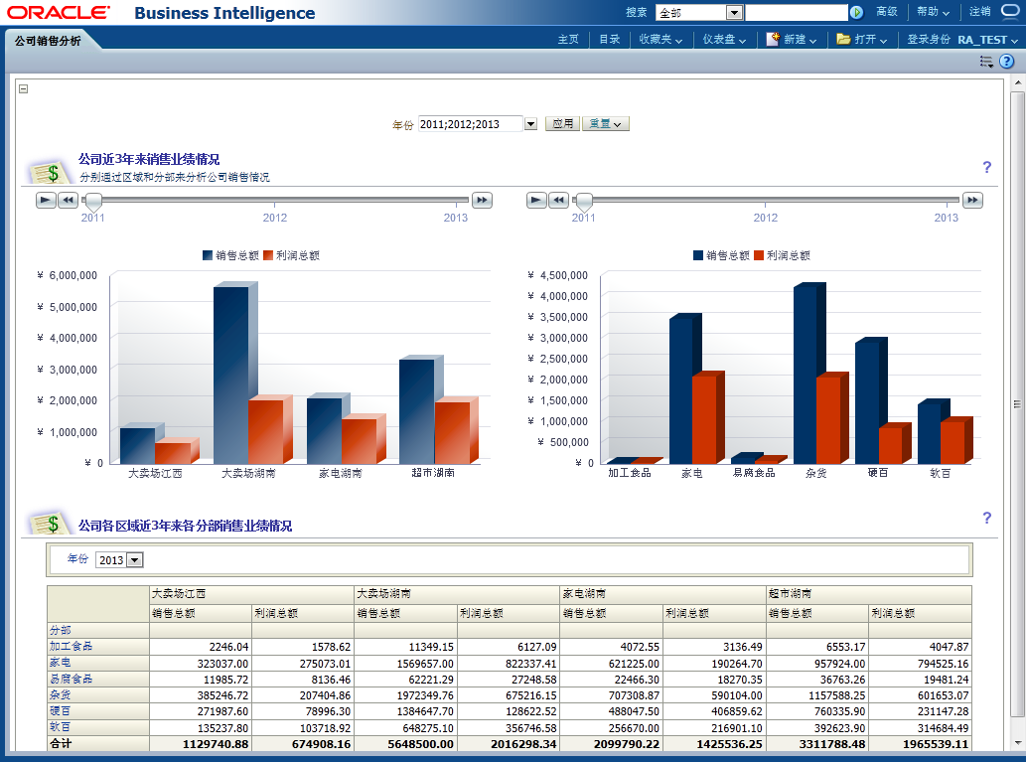
Retail Analytics Story——Dashboard
Notes:
ETL Processing: Overview
The main point to note here is that ETL is a parallel process。Graphic and callouts define the ETL process.

Slide 30

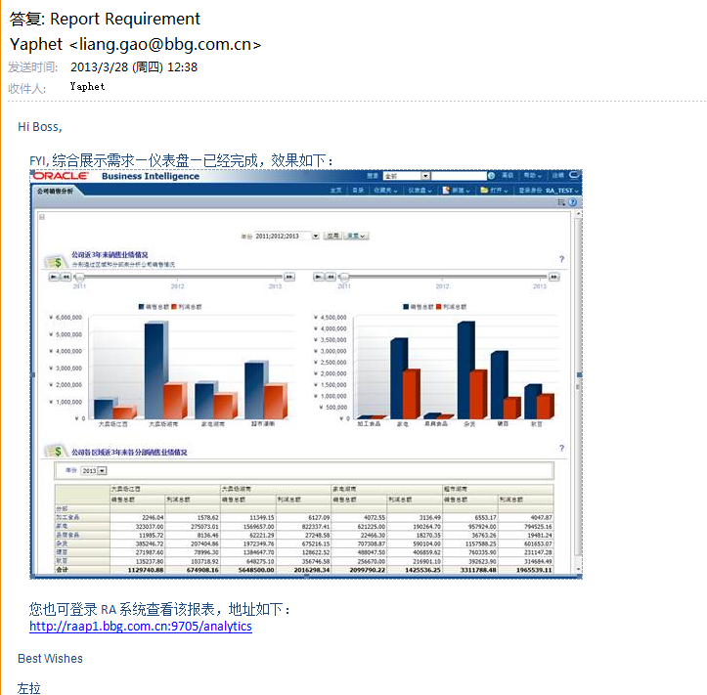
Retail Analytics Story——Question——Scenario 4
Scen 4：
Notes:
ETL Processing: Overview
The main point to note here is that ETL is a parallel process。Graphic and callouts define the ETL process.

Slide 31

Retail Analytics Story——iBot——新建代理
Notes:
ETL Processing: Overview
The main point to note here is that ETL is a parallel process。Graphic and callouts define the ETL process.

Slide 32





Retail Analytics Story——iBot——设置代理
Notes:
ETL Processing: Overview
The main point to note here is that ETL is a parallel process。Graphic and callouts define the ETL process.

Slide 33


Retail Analytics Story——iBot——保存
Notes:
ETL Processing: Overview
The main point to note here is that ETL is a parallel process。Graphic and callouts define the ETL process.

Slide 34
Retail Analytics Story——Summary
需求：
维度
指标
Answer：
组合布局
表格视图
数据透视表视图
图表视图(条形图视图)
Notes:
ETL Processing: Overview
The main point to note here is that ETL is a parallel process。Graphic and callouts define the ETL process.

Slide 35
Retail Analytics Story——Summary
Dashboard：
新建/布局
仪表盘提示
iBot：
新建iBot
设置自动配送
Notes:
ETL Processing: Overview
The main point to note here is that ETL is a parallel process。Graphic and callouts define the ETL process.

Slide 36
Retail Analytics Story——Q&A
Q&A
Thanks！
Notes:
ETL Processing: Overview
The main point to note here is that ETL is a parallel process。Graphic and callouts define the ETL process.

